Slide 1
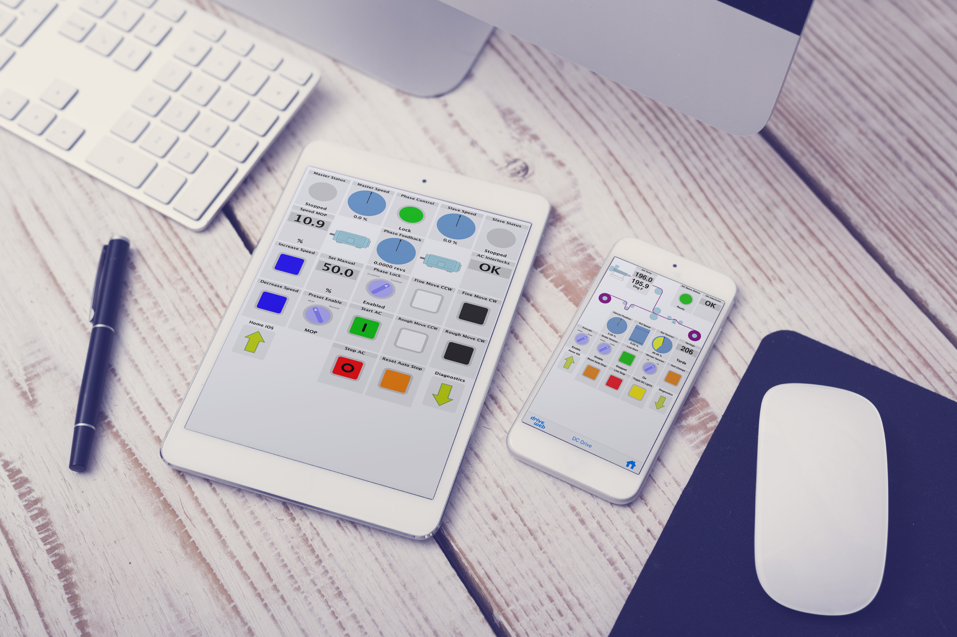



Corporate Overview
Bardac . . . the safe bet!

Slide 2
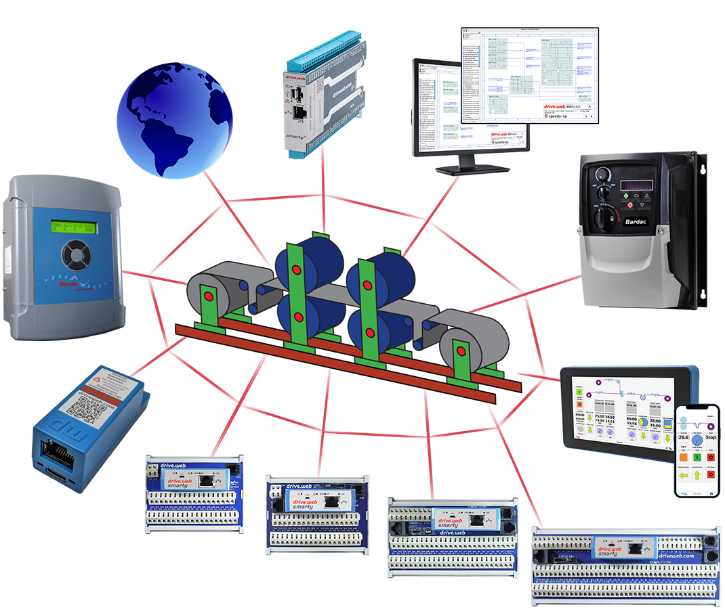

Bardac Drives & Automation
AGENDA
Corporate Background
AC & DC Drives & Motors overview
drive.web automation technology overview
Global view with a local focus

Slide 3
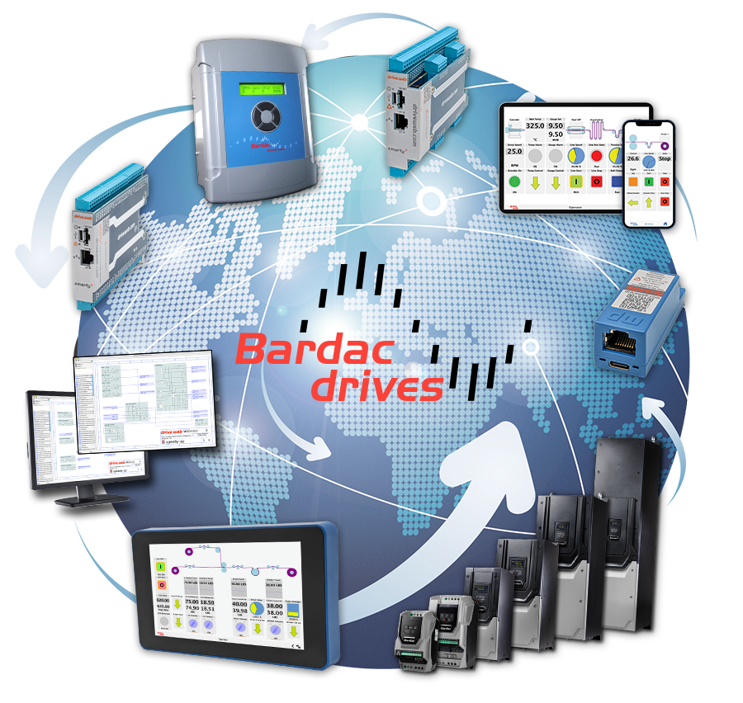
Bardac Drives & Automation
PRODUCTS
AC Drives 0.1 to 400 horsepower
DC Drives 0.1 to 2,000+ horsepower
drive.web automation technology
DC servo linear amplifier drives
AC & DC motors
Engineered systems (UL 508A)
Worldwide sales & service

Slide 4

Bardac Drives & Automation
Quick History
1992 – Founded in Reston Virginia with a primary focus on selling DC drives throughout North America formerly doing business as, Sprint Electric Corp.
1997 – Launched first AC drives
1998 – Relocated to Stevensville, MD where the factory headquarters is still located today.
1999 – Began selling AC flux vector drives.
2002 – The first drive.web internet accessible distributed control product is launched.

Slide 5
Bardac Drives & Automation
AC DRIVES
Closed loop vector drives up to 400 HP (230 & 460V)
Sensorless vector drives up to 400 HP (230 & 460V)
600VAC drives up to 150 HP
HVAC & pump drives up to 400 HP (230 & 460V)
Industrial general purpose VFDs up to 50 HP
115/230/460 Volts, all purpose features
Single Phase Motor VFDs up to 1.5 HP (115 & 230V)
NEMA 12 drives up to 400 HP – CLV, HVAC, SV, GP, SP
NEMA 4X drives up to 30 HP – CLV, SV, HVAC, GP, SP

Slide 6
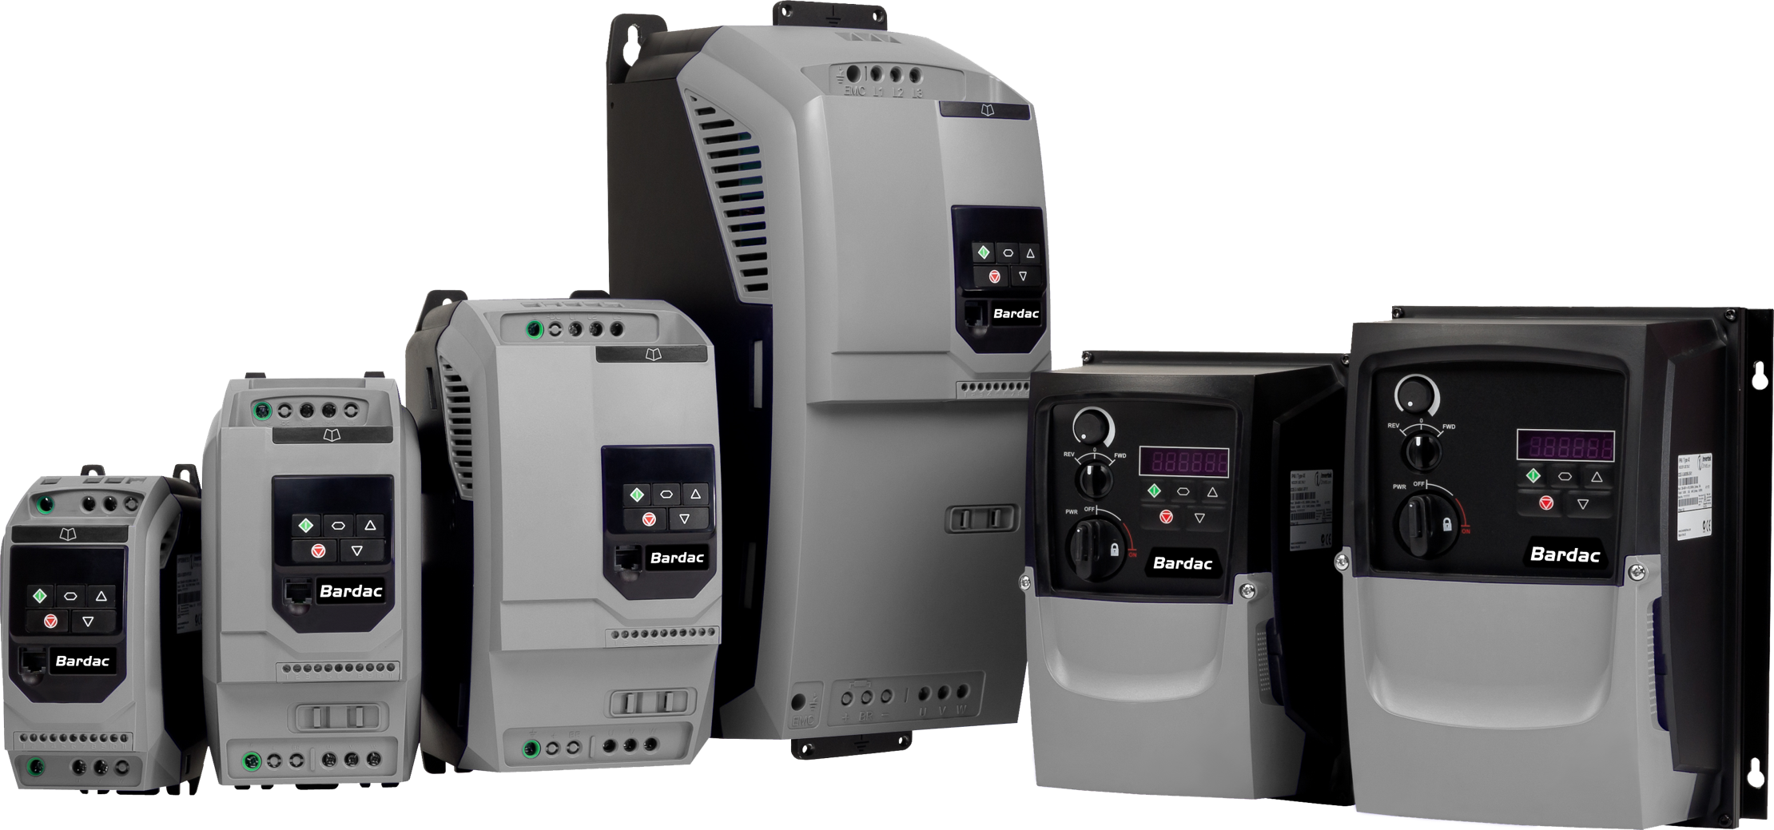
Bardac Drives & Automation
AC DRIVES
Closed & open loop vector drives
Systems drives
General purpose VFDs
NEMA 12 & NEMA 4X drives

Slide 7
Bardac Drives & Automation
AC DRIVE FAMILY FEATURES
High frequency switching for quiet operation
Built in a DB switch in size 2 and up
ModbusRTU serial port up to 115 kbps
Spin start, PI control, boost, trip memory
Optional remote keypad & display
Optional ModbusTCP/IP over Ethernet
Optional peer-to-peer Ethernet networking
Optional drive.web programmable control
Optional distributed i/o over Ethernet

Slide 8
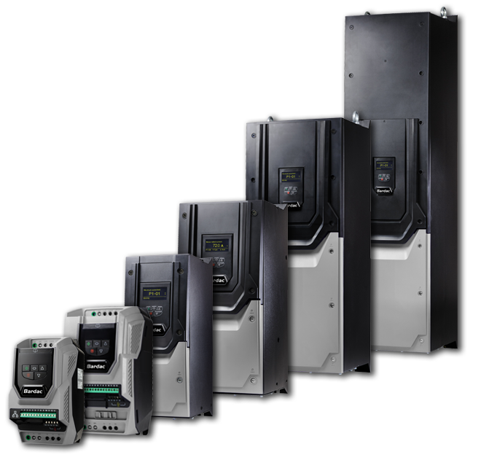
Bardac Drives & Automation
P2 OPEN & CLOSED LOOP VECTOR DRIVES
IP20, NEMA 4X, & NEMA 12 enclosures
Ratings to 400HP
230/460/600 volts
Expandable systems features
DC bus sharing
savvy graphical programming
Optional encoder feedback
Optional drive.web control
Many fieldbus options available

Slide 9
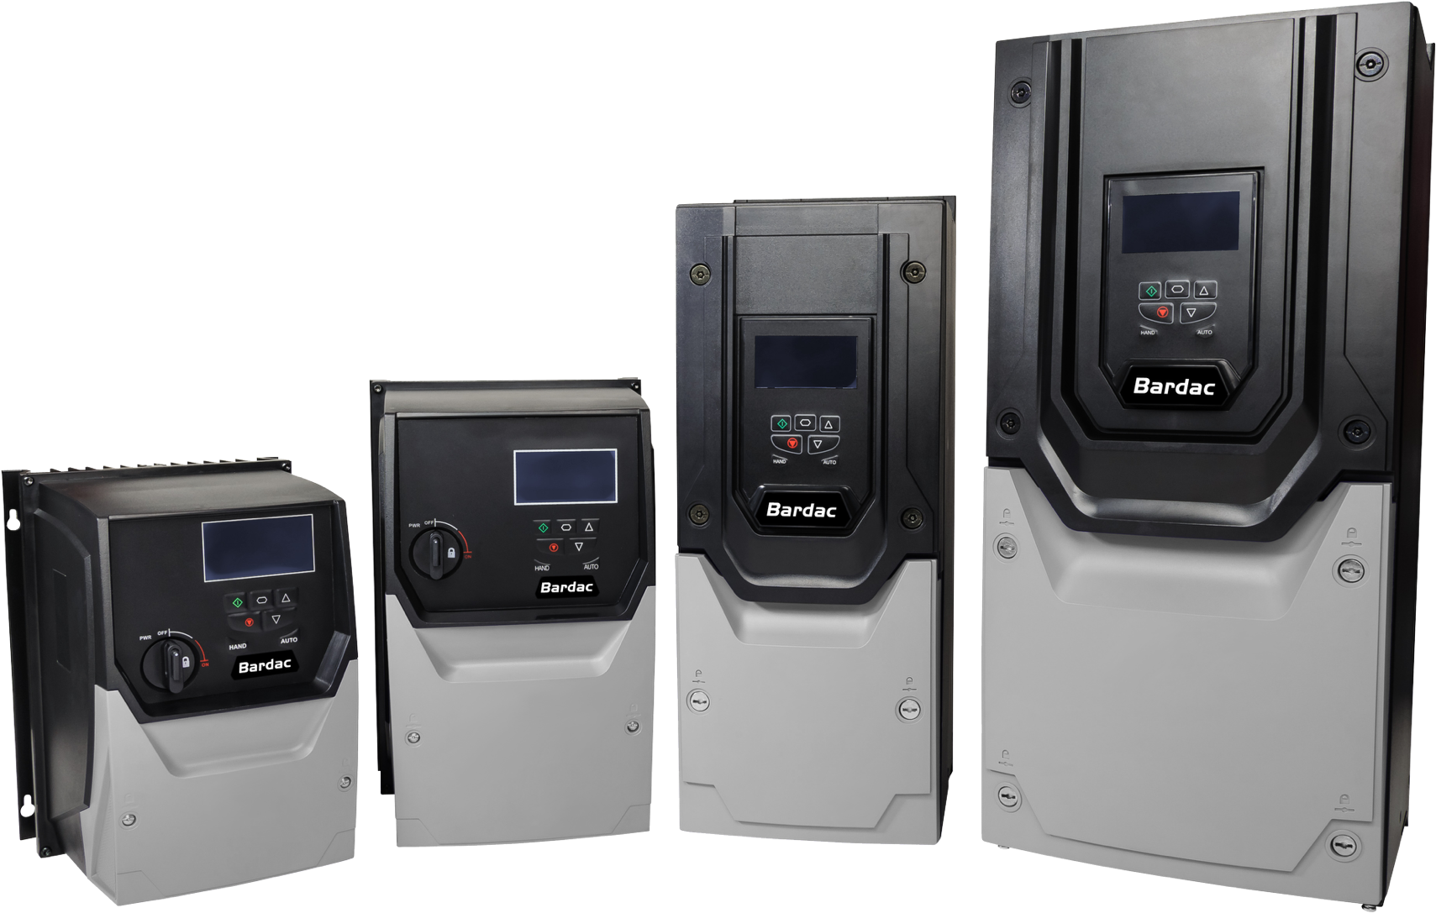
Bardac Drives & Automation
V3 HVAC, FAN, & PUMP DRIVES
IP20, NEMA 4X, & NEMA 12 enclosures
Ratings to 400HP
230/460/600 volts
Energy efficient >98%
Low input harmonics
BACnet, ModbusRTU standard
savvy graphical programming
HVAC & pump functions
Optional drive.web control

Slide 10
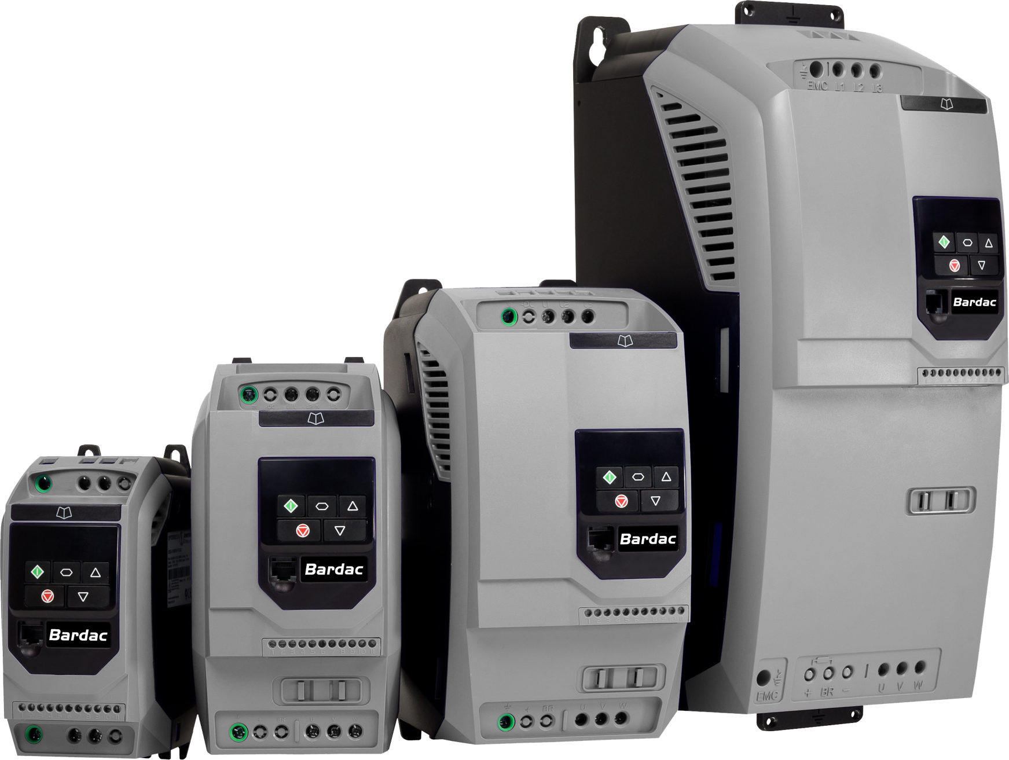
Bardac Drives & Automation
E3 SERIES GENERAL PURPOSE VFDs
IP20 & NEMA 4X enclosures
Ratings to 50HP
230/460 volts
High frequency switching for quiet operation
Brake transistor, size 2 and up
ModbusRTU, RS485 115 kbps
Spin start, PI control, boost
Optional drive.web control
Optional Ethernet

Slide 11
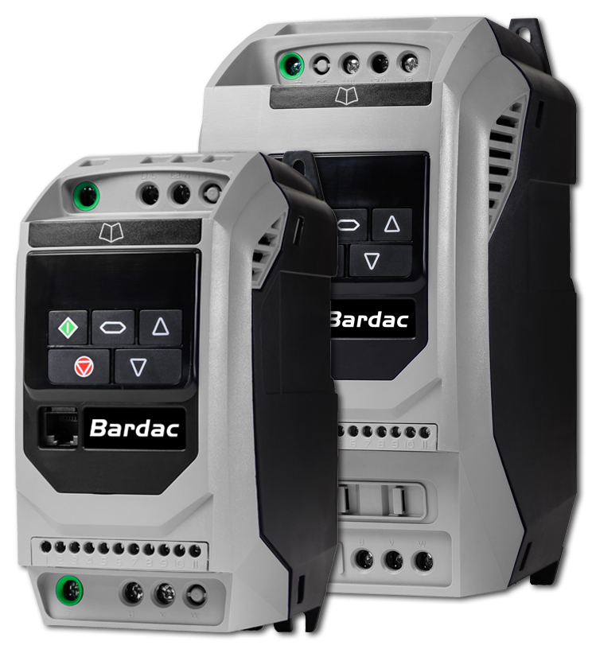
Bardac Drives & Automation
E3 SERIES SINGLE PHASE MOTOR VFDs
IP20 & NEMA 4X enclosures
For use with Shaded Pole or Permanent
Split Capacitor motors
For use in variable torque fan & centrifugal
pump type applications
115 volts, 1Ø up to 0.75 HP
230 volts, 1Ø up to 1.5 HP
Expandable i/o & systems features

Slide 12
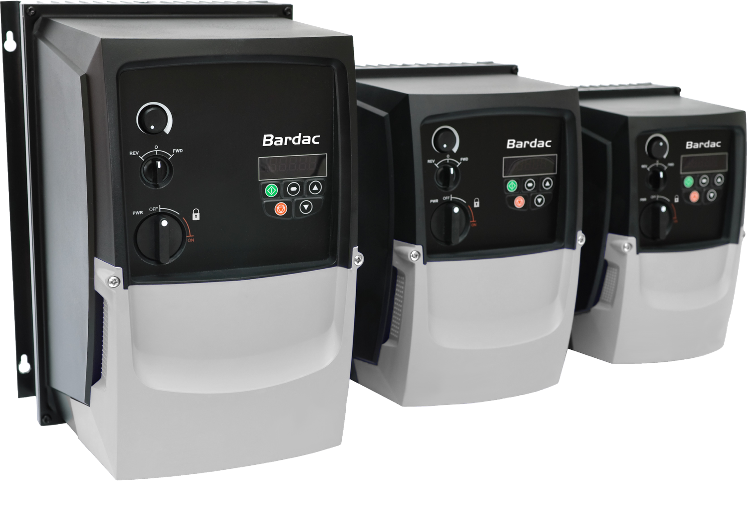
Bardac Drives & Automation
NEMA 4X (IP66) DRIVES
For harsh, wet, dirty environments
Vector up to 30HP
General purpose VFDs up to 30HP
HVAC & Pump drives up to 30HP
Basic versions with keypad & display
Switched versions with:
  Lockable isolator switch
  FWD/OFF/REV switch
  Speed pot
Outdoor Rated

Slide 13
Bardac Drives & Automation
DC DRIVES – REGEN & NON-REGEN
1-phase OEM drives up to 2 HP
1-phase systems drives up to 10 HP
3-phase digital systems drives up to 2000+ HP
3-phase analog drives up to 150 HP
3-phase digital separate SCR stack controllers
3-phase 12 pulse SCR stack controllers
3-phase slip ring motor controllers to 2000 HP

Slide 14
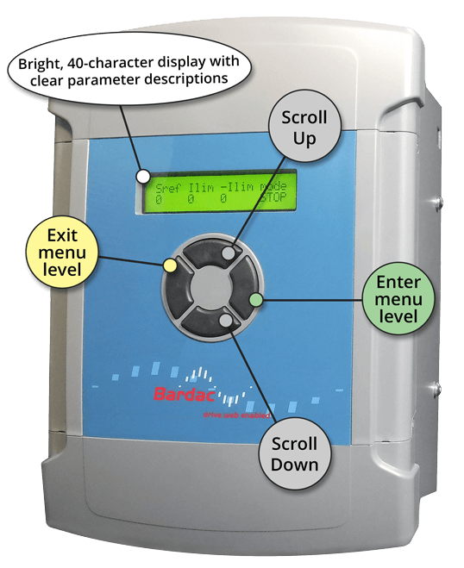
Bardac Drives & Automation
DC DRIVES
Single Phase, regen & non-regen to 10 HP
3-Phase, regen & non-regen to 2000+HP
3-Phase 12 pulse drives
Linear amplifier servos up to 12 amps
Separate Stack Controllers
Slip ring motor controllers to 2000 HP
Annealer Controllers
Field Regulators

Slide 15
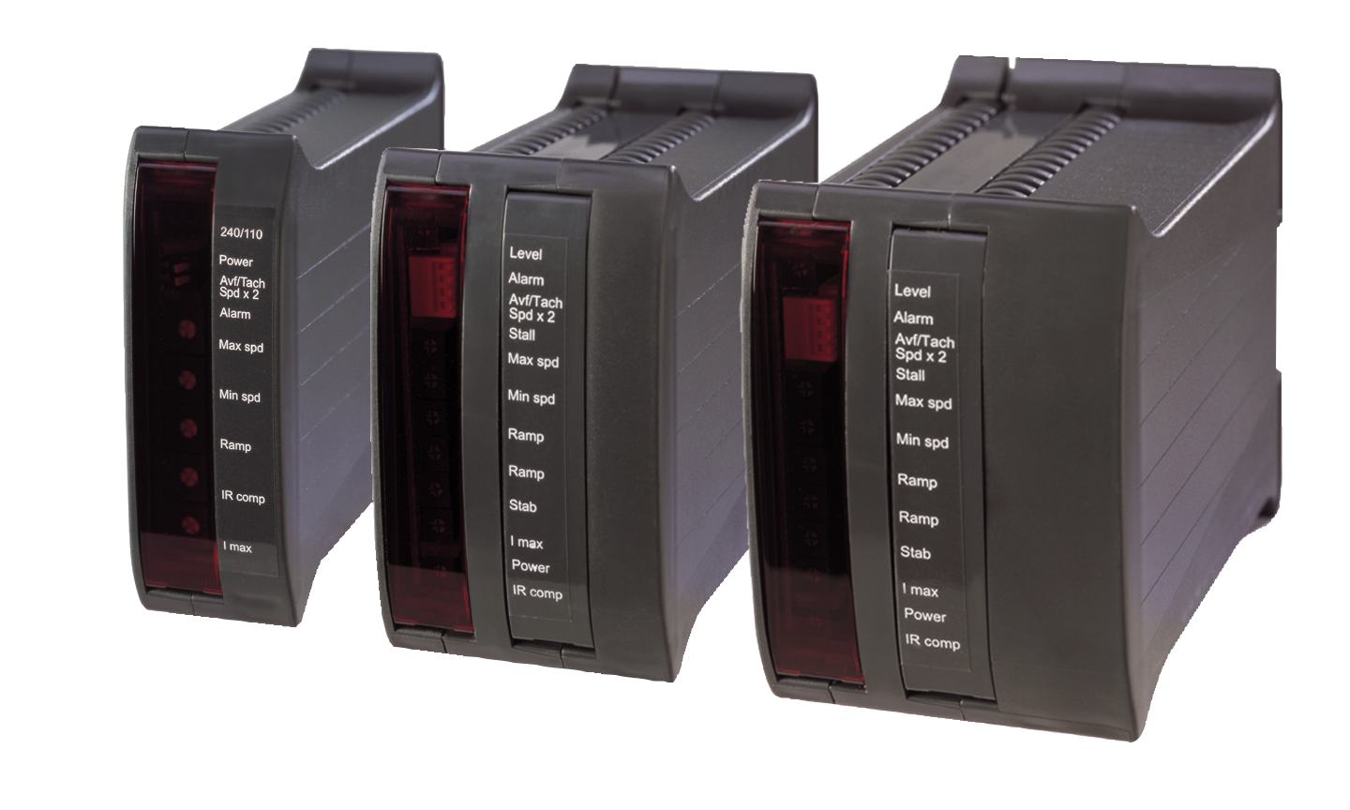
Bardac Drives & Automation
K-SERIES, OEM DC DRIVES – REGEN & NON-REGEN
Up to 2 HP
DIN mounting
Plug in terminals
Arm volts or tach f/b
Isolated versions
115/230 VAC selectable for
90/180VDC arm
Adjustable ramps, max/min speed,
IR comp
Fields up to 1 amp
Volume discounts

Slide 16
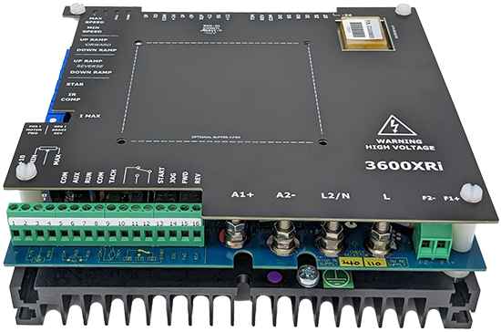
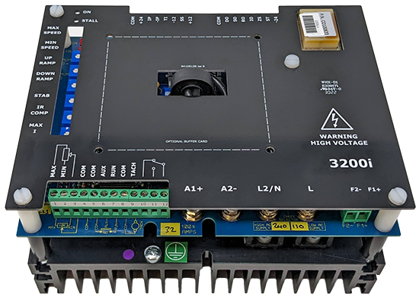
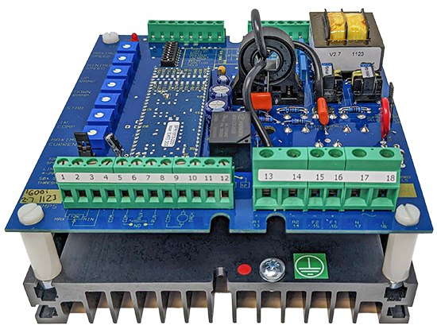
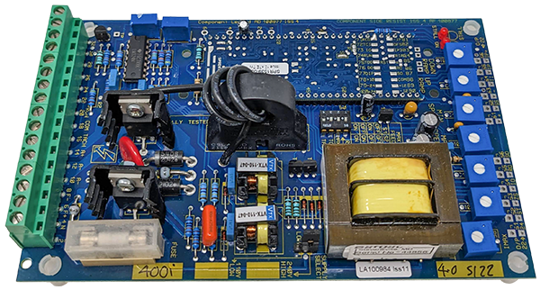
Bardac Drives & Automation
DC DRIVES – 1-PHASE SYSTEMS DRIVES
Regen up to 36A, non-regen up to 48A
115/230 VAC selectable for 90/180VDC arm
230/460 VAC selectable for 180/360VDC arm
Adjustable ramps, max/min speed, IR comp
European voltage versions

Slide 17
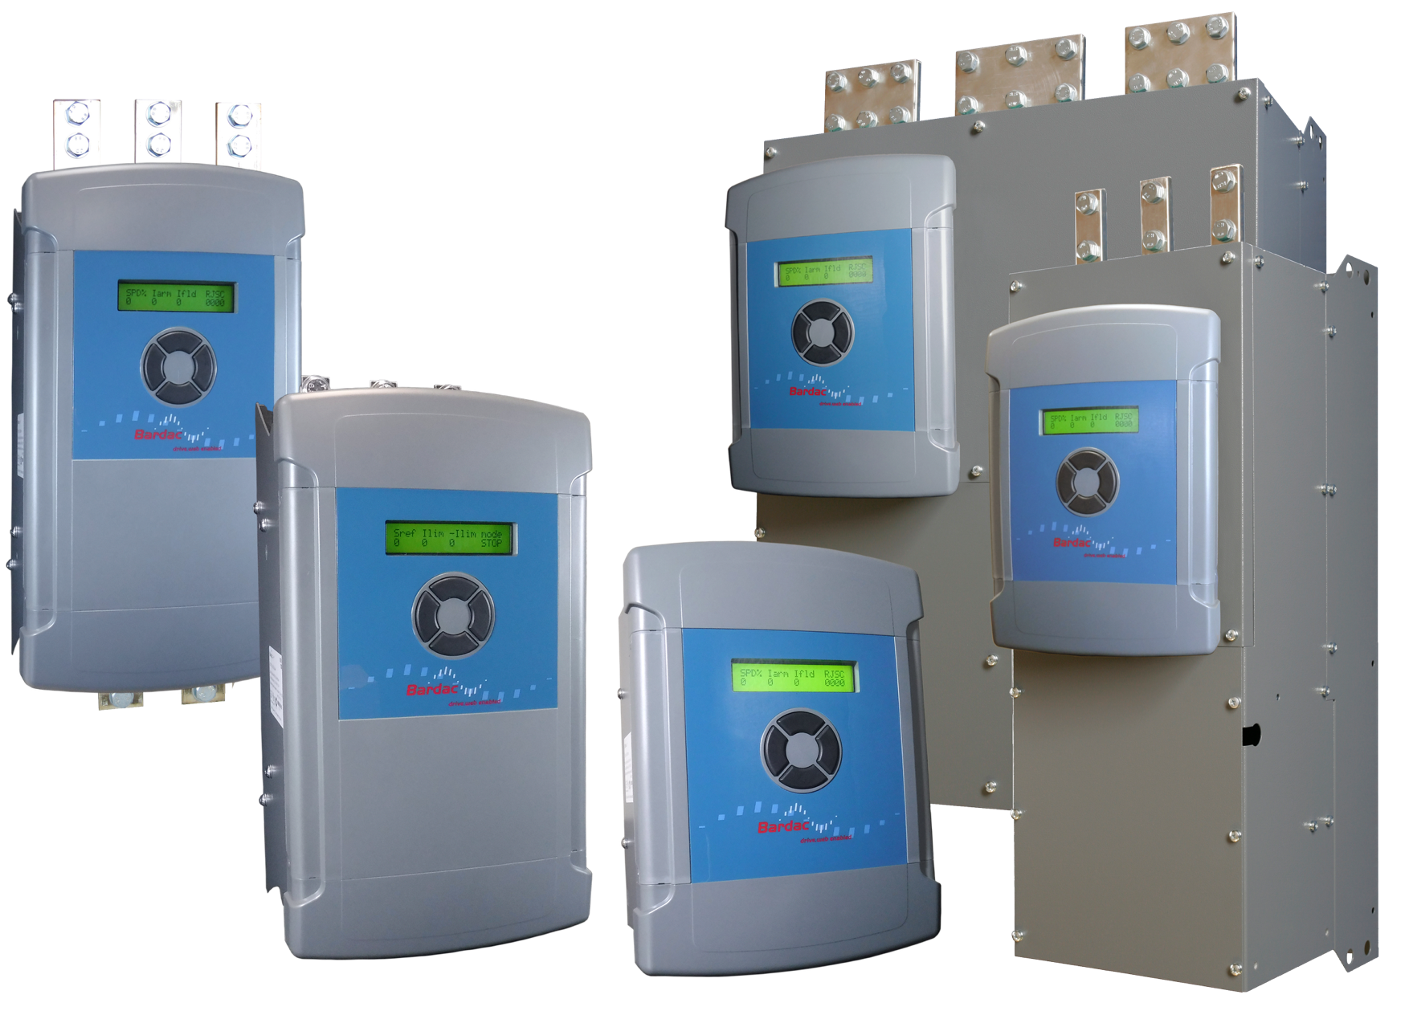
Bardac Drives & Automation
PLX SERIES DC DRIVES – 3-PHASE DIGITAL DRIVES TO 2000+ HP
Compact packages
8.5” x 11” thru 75HP!
High performance
AVF/tach/encoder f/b
Auto field controller
drive.web Ethernet
savvy graphical tools
Extensive, flexible i/o
“power” version with fuses, contactor, etc.
International ratings
Many fieldbus options available

Slide 18
Bardac Drives & Automation
drive.web Distributed Control Technology
System integration without PLC
Cost effective in systems of any size
Peer-to-peer Ethernet networking
Internet accessible
Graphical function block tools
Onboard data storage
Powerful system navigation
savvyPanel touch screens
Wi-Fi roaming with iPad, iPhone, etc.
Easy links to most drives, PLCs, etc.
Supports enterprise integration
savvy intuitive signal flow tools
Online training and field support

Slide 19
Bardac Drives & Automation
drive.web Automation Technology

Slide 20
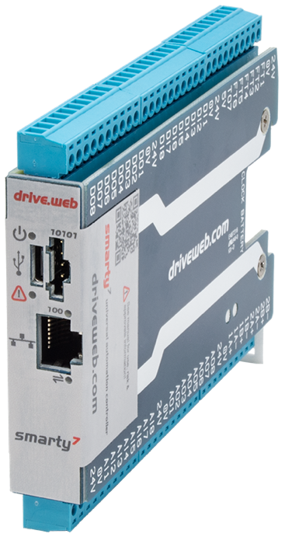
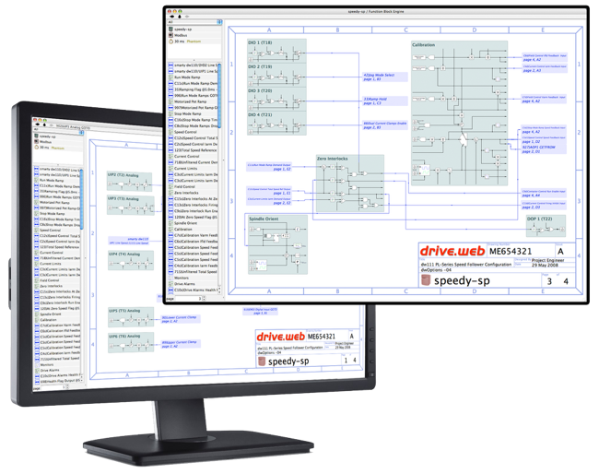
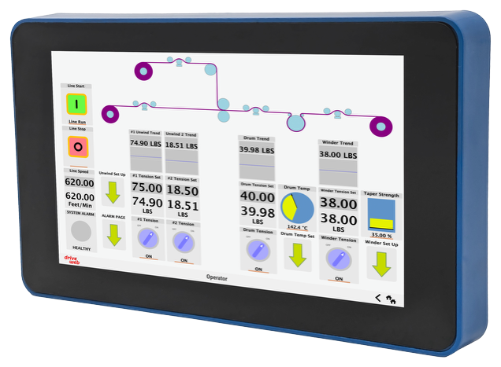
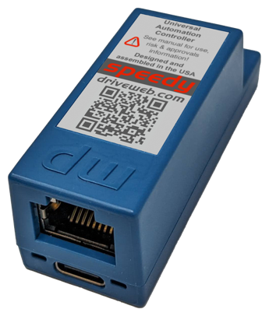
Bardac Drives & Automation
drive.web product overview
smarty
DIN mount controllers with flexible analog, logic & encoder I/O
16 points of high resolution I/O
savvy
Smart, intuitive
graphical tools for device
programming, system
design & monitoring
speedy
Miniature drive interface controllers with gateway to ModbusTCP/IP, ModbusRTU, EIP/PCCC, etc.
savvyPanel
Smart, touch screen
operator station technology

Slide 21
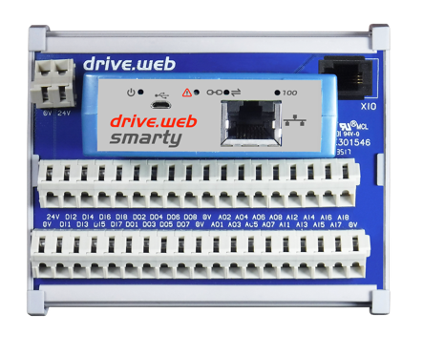
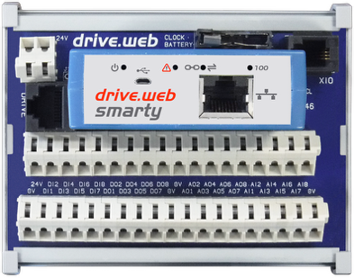

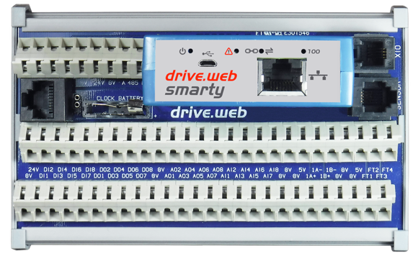
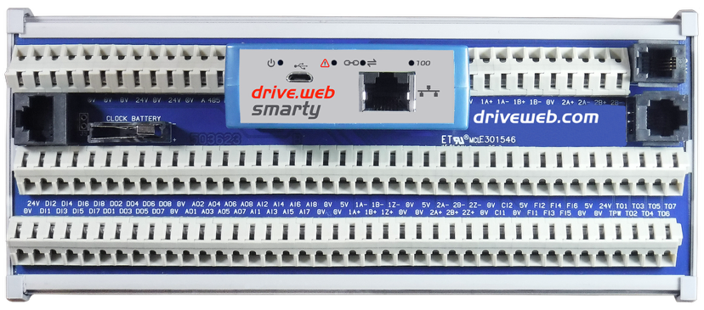
Bardac Drives & Automation
smarty universal automation controllers
PLC, Motion Controller, and Process Controller . . . all in one!
drive.web distributed control over Ethernet
Direct field wiring for easier, quicker, cost-saving installation
Homogeneous integration for drives, HMIs, remote I/O
savvy system design tools
Right for the IIoT future
Easy, intuitive, affordable, expandable
For systems of any size or complexity
Designed and assembled with innovation in the USA
smarty¹
smarty²
smarty⁷
smarty³
smarty⁴

Slide 22
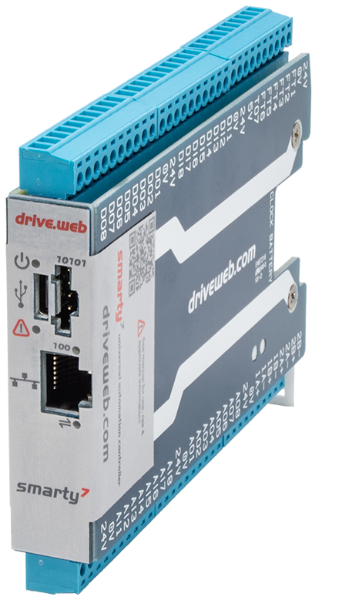
Bardac Drives & Automation
smarty⁷ dw250
8, Analog Inputs: ±11V (16 bits) analog in, or 5/24 VDC digital in
8, Analog Outputs: ±10.5VDC, 10mA
8, Digital Inputs: 50VDC max, 8VDC threshold, 3V hysteresis, 1kHz
8, Digital Inputs: 24VDC, up to 300mA shared
6, Fast I/O: digital inputs (100Khz) or stepper/digital out (500Khz)
1, Fast timing/stepper/frequency output: 30 VDC 100Khz
2, Encoder inputs: Quadrature A/B (or 1, ABZ), 5/24V, 1Mhz
ModbusRTU client port (RS485) server optional)
ModbusTCP/IP client and server (Ethernet)
EthernetIP/PCCC (Ethernet)
Accelerometer, barometer, thermometer, hygrometer
Advanced Process Control Library
Winder & Web Tension Control Library
Advanced Math Library
savvyPanel touch screen controller
Solar Position Library
Advanced Motion Library

Slide 23
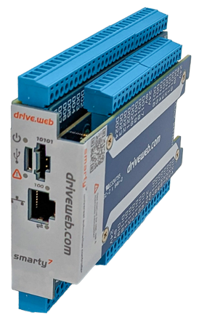
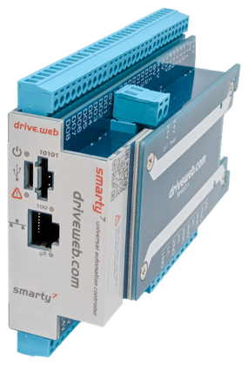
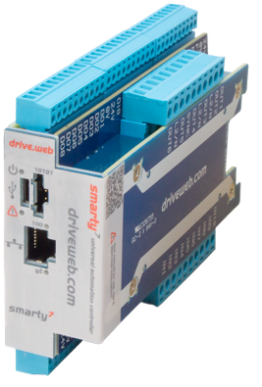
Bardac Drives & Automation
smarty⁷-XD: Extended Digital I/O
smarty⁷-RL: Extended Relay I/O
Model: dw250-DM-XDPD
All of the smarty⁷ features plus:
                16, 5-24VDC Digital Inputs
                16, 24VDC Digital Outputs also configurable as Digital Inputs
                All I/O have common 0V
                1.0” x 3.5” x 4.8” (27x90x121 mm)
Model: dw250-DM-RLPD
All of the smarty⁷ features plus:
                2, Form C (Changeover) contacts
                2, Form A (single contact, normally open)
                For use with common power supply lines
                1.4” x 3.5” x 4.8” (36x90x121 mm)
smarty⁷-HV: Extended High Voltage Digital I/O
Model: dw250-DM-HVPD
All of the smarty⁷ features plus:
                10, 120/240VAC Digital Inputs
                6, 120/240VAC Digital Outputs
                For use with common power supply lines
                1.3” x 3.5” x 4.8” (33x90x121 mm)

Slide 24
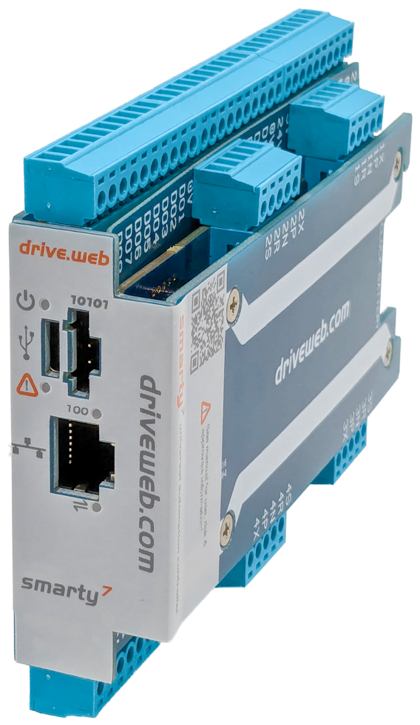
Bardac Drives & Automation
smarty⁷-XA: Extended Precision Analog Inputs
Model: dw250-DM-XAPD
Four precision analog inputs, each isolated from each other and the controller. Along with all of the smarty⁷ features, each channel is individually configurable for:
Thermocouple (most common types supported) with cold junction compensation
RTD temperature sensor (2, 3, & 4 wire)
Strain gauge loadcell (Wheatstone bridge type)
Semiconductor tension transducer, full bridge & half bridge
mV sensing with ranges from 10mV to 2000mV
Compact package only 1.0” x 3.5” x 4.8” (27x90x121 mm)

Slide 25
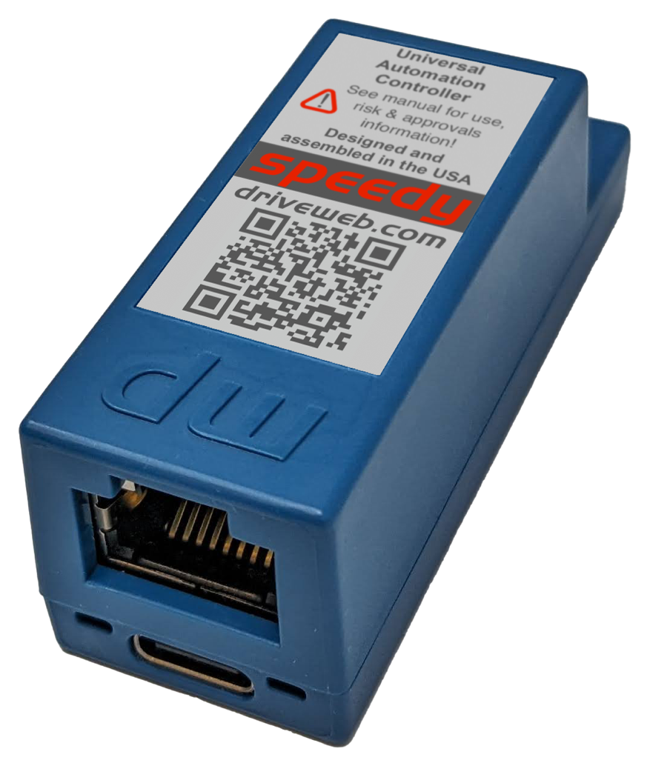
Bardac Drives & Automation
speedy dw270
Model dw270-DM-S7MT
Standard Features
drive.web distributed process control
10/100Base-T(X) Ethernet.
Update firmware with savvy software.
Ultra-compact, may be permanently bonded inside equipment.
High-speed CANopen up to 1Mb/s.
ModbusRTU on EIA485 up to 500kb/s.
Basic Control function block library
Compact package only 0.91” x 0.89” x 2.42” (23x22.5x61.5 mm)

Slide 26
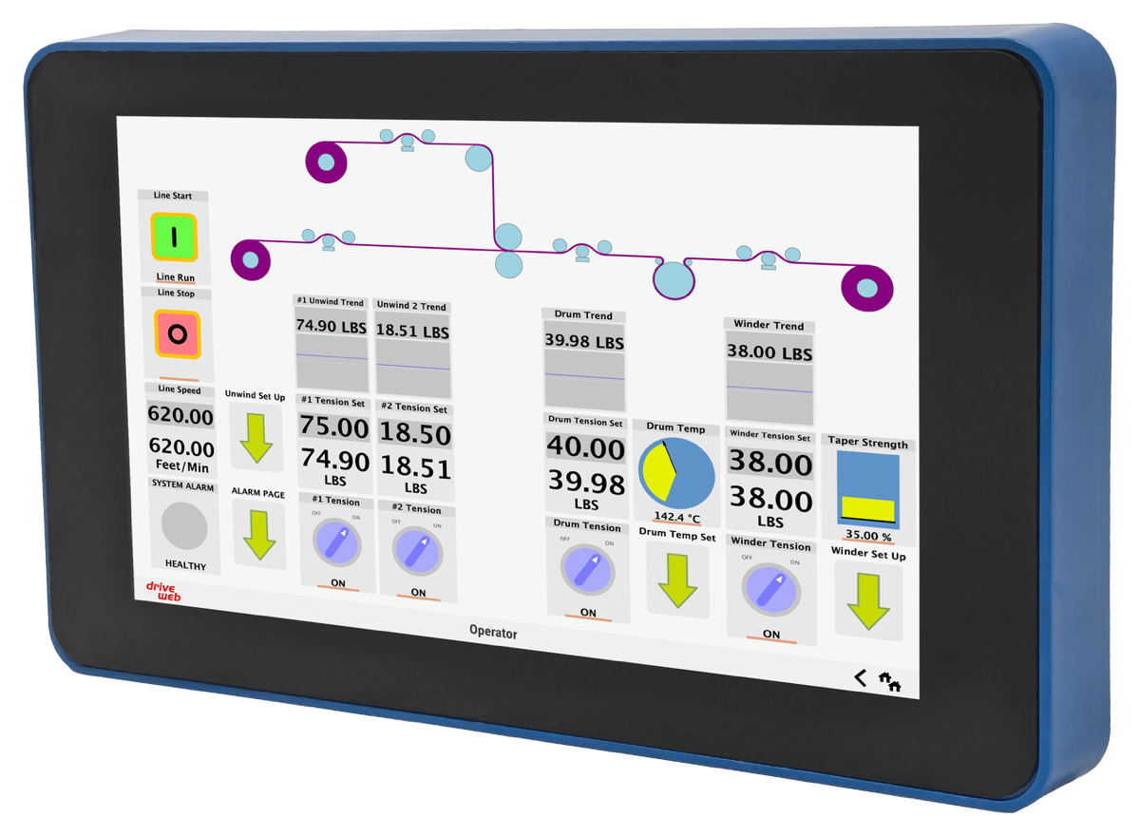
Bardac Drives & Automation
savvyPanel Touch dw260
Model: dw260-070
Standard Features
drive.web distributed process control
10/100Base-T(X) Ethernet.
Update firmware with savvy software.
Ultra-compact, may be permanently bonded inside equipment.
High-speed CANopen up to 1Mb/s.
ModbusRTU on EIA485 up to 500kb/s.
Basic Control function block library
Compact package only 0.91” x 0.89” x 2.42” (23x22.5x61.5 mm)

Slide 27
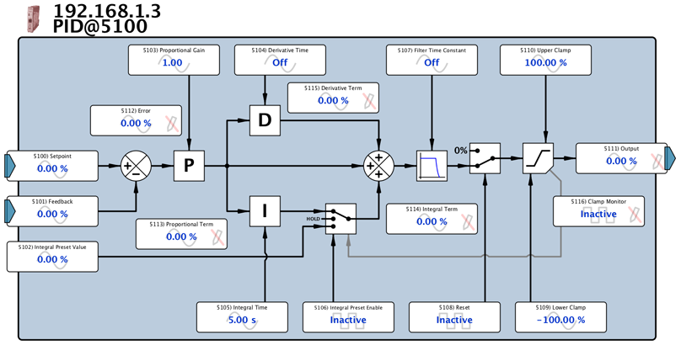
Bardac Drives & Automation
drive.web KEY GRAPHICAL FUNCTION BLOCKS
Arithmetic, logic, timers, comparators, switches
Presets, latches, filters, counters, state machine
Linear & S-ramps, PIDs, profilers
Winder diameter, torque, taper calculation
“Electronic line shaft”, phase lock, speed lock
Encoder registration, indexing & orientation
Sun position calc. for solar energy systems
Event driven email from devices

Slide 28
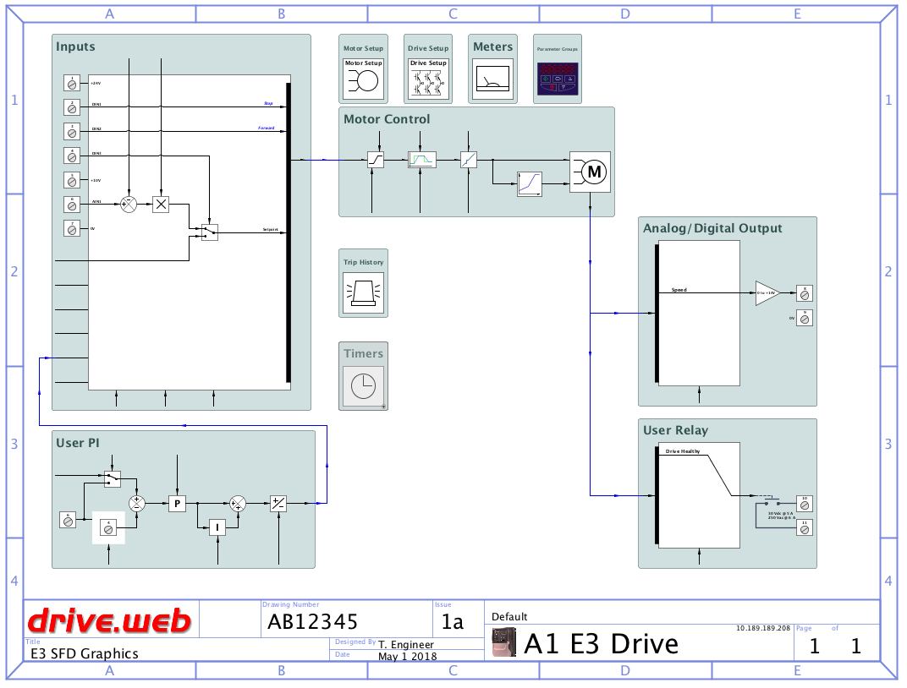
Bardac Drives & Automation
drive.web PROGRAMMING FEATURES
Drag & drop connections
Page and level browse navigation controls
Drill down, jump, filter, search, pan, zoom
Hover text help
Contextual menus for get info, editing, naming, etc.
Instant links to the built in manual
Trend charts with data export
Docks for easy parameter organization

Slide 29
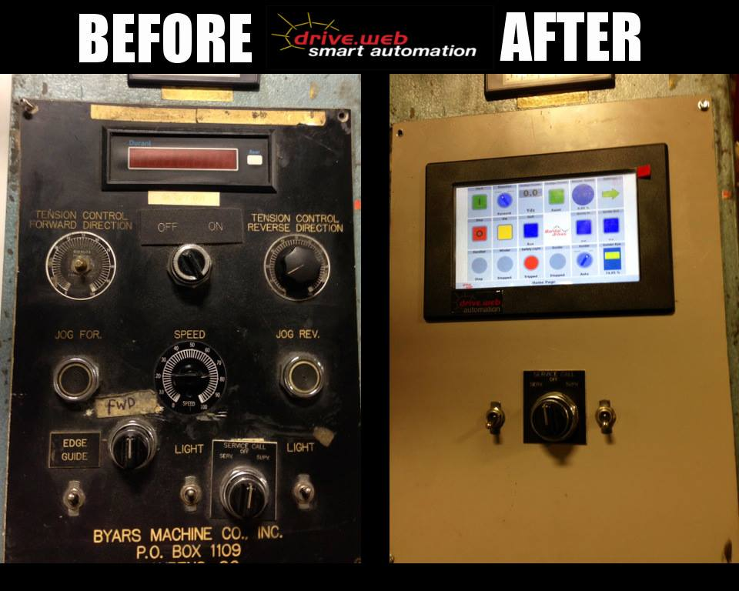
Bardac Drives & Automation
drive.web KEY FEATURES
Provides distributed control over Ethernet
Easy interface to most drives, MMIs, etc.
Easier, cheaper, faster than a PLC
Intuitive savvy signal flow programming tools
Entire system configuration stored in devices
Field upgradable firmware options
Multi-user tools with Internet access
All system devices accessible from one point
savvy runs on Windows, macOS & Linux
Powerful password protection
Event driven text/email from devices

Slide 30
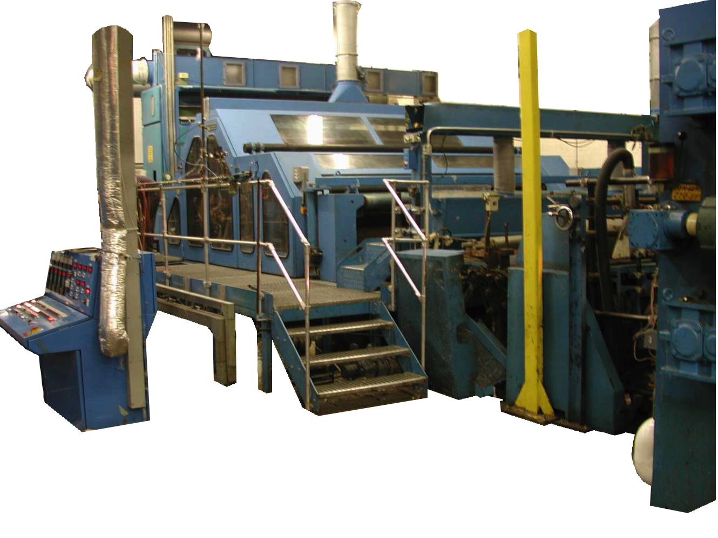
Bardac Drives & Automation
drive.web KEY APPLICATIONS
Process lines
Steel & paper mills
Plastic & metal extrusion lines
Printing, coating, laminating, winding
Material handling, conveyors, hoists
Petro-chemical, pharmaceutical, flow control
HVAC drive coordination

Slide 31
Bardac Drives & Automation
THANK YOU!
40 Log Canoe Circle
Stevensville, MD 21666
(410) 604-3400
bardac.com | driveweb.com | Automationthings.com

